Slide 1

Energy Consumption Analysis
Presented by-
MEGHAMALA BAIPOTHU Batch No. 523

Slide 2
About Me
B.TECH – Data Science
Why Data Science?
I chose Data Science because I enjoy analyzing data, finding useful insights, and helping businesses make better decisions.
Linkedin URL: https://www.linkedin.com/in/meghamala-baipothu-77138525a
GitHub URL: https://github.com/MeghamalaBaipothu

Slide 3
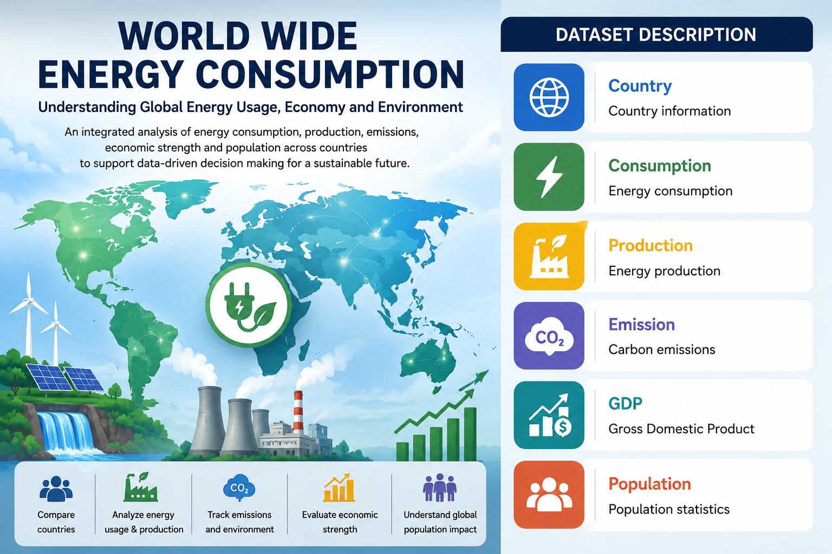
Agenda
Business Problem
Problem Statement
Introduction
Data Description
ER Diagram & Cardinalities
Analysis Queries
Business Insights
Recommendations & Future Scope
Conclusion

Slide 4
Business Problem
Organizations and governments often struggle to analyze worldwide energy data across multiple datasets and energy sources.
Challenges include:
Energy consumption monitoring
Energy production analysis
Carbon emission tracking
GDP and economic growth analysis
Population impact assessment
Country-wise energy comparison
Data consistency and reporting
An integrated Energy Consumption Analysis System is required to centralize global energy data, automate analysis, and generate meaningful insights for sustainable energy planning and informed decision-making.

Slide 5
Problem Statement
Design and implement Energy Consumption Analysis System that:
Stores worldwide energy consumption and production data efficiently.
Maintains country-wise GDP and population information.
Tracks carbon emissions across different energy types.
Compares energy production and consumption across countries.
Analyzes trends in energy usage, emissions, and economic growth.
Generates analytical reports to support sustainable energy planning and data-driven decision-making.
The system should maintain data integrity by establishing relationships between datasets using primary and foreign keys, ensuring accurate and consistent analysis.

Slide 6
Introduction
The Energy Consumption Analysis is a SQL-based project developed using MySQL.
The project analyzes six interconnected datasets:
Country
Consumption
Production
Emission
GDP
Population
Benefits
Centralized energy data analysis
Compare energy production and consumption
Analyze GDP, population, and emissions
Generate business insights using SQL
Support better decision-making

Slide 7
Data Description
Dataset Overview:
Dataset Statistics
Total Employees: 60
Total Tables: 6
Relational Database Design
Foreign Key Constraints Implemented
Dataset | Description
Country | Country details
Consumption | Energy consumption data
Production | Energy production data
Emission | Carbon emission data
GDP | Gross Domestic Product data
Population | Population data

Slide 8
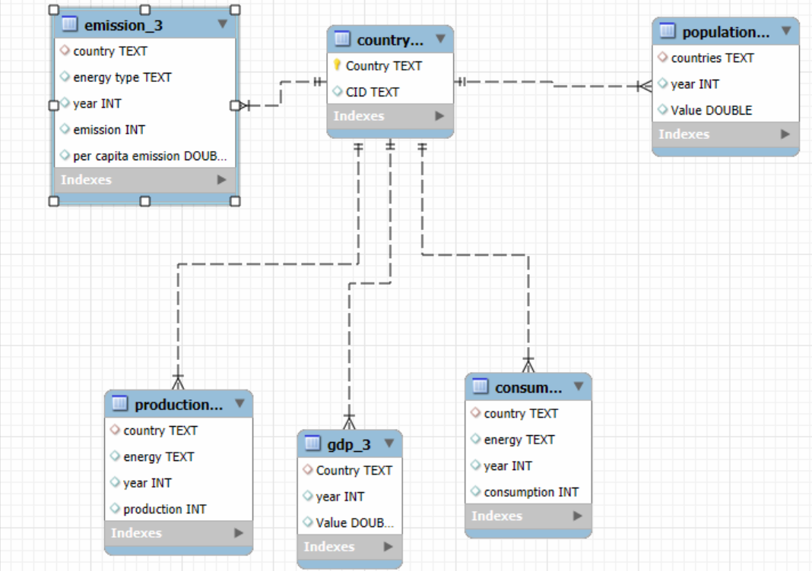
ER Diagram & Cardinalities
.
Cardinalities:
Relationships | Cardinality
Country → Consumption | 1 : N
Country → Production | 1 : N
Country → Emission | 1 : N
Country → GDP | 1 : N
Country → Population | 1 : N

Slide 9
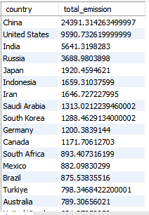
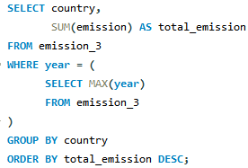
Analysis Queries
Query 1: What is the total emission per country for the most recent year available?

Slide 10
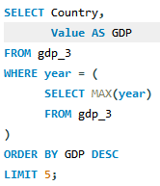
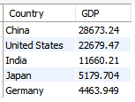
Analysis Queries
Query 2: What are the top 5 countries by GDP in the most recent year?

Slide 11
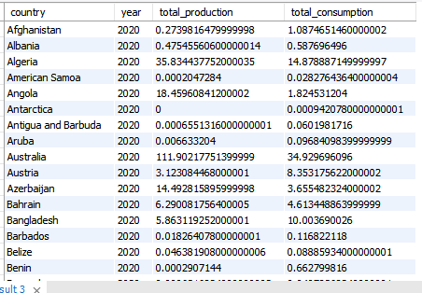
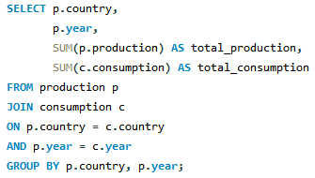
Analysis Queries
Query 3: Compare energy production and consumption by country and year.

Slide 12
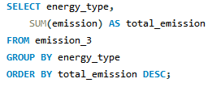

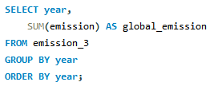

Analysis Queries
Query 4: Which energy types contribute most to emissions across all countries?
Query 5: How have global emissions changed year over year?

Slide 13
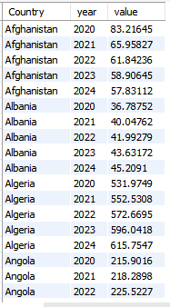
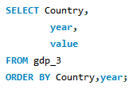
Analysis Queries
Query 6: What is the trend in GDP for each country over the given years?

Slide 14
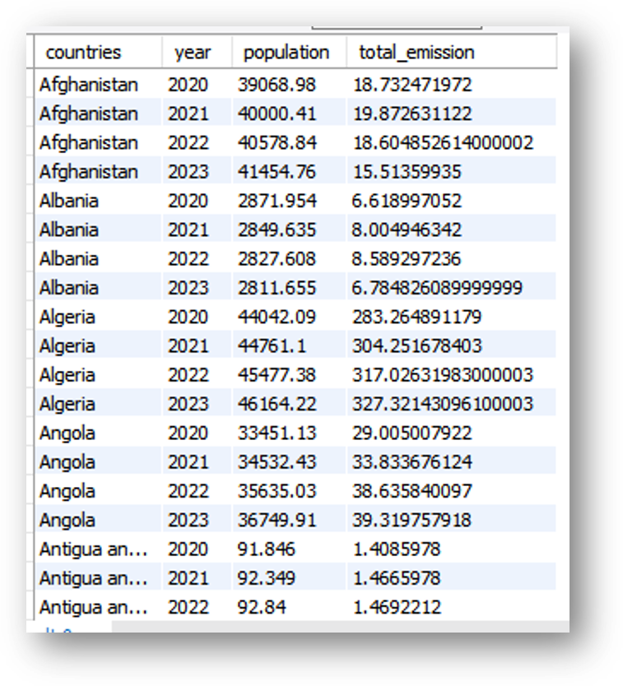
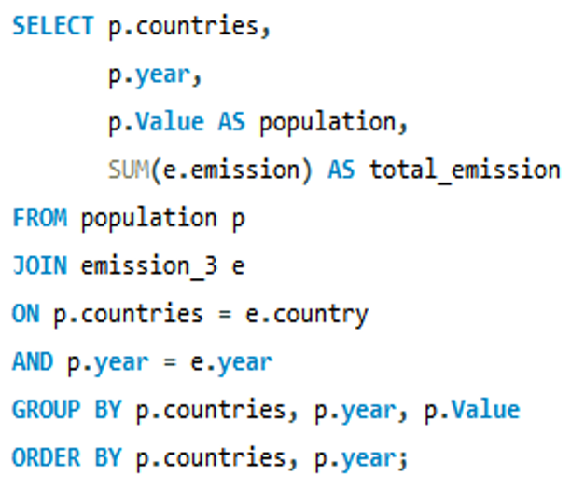
Analysis Queries
Query 7: What is the Population Growth vs Total Emissions?

Slide 15
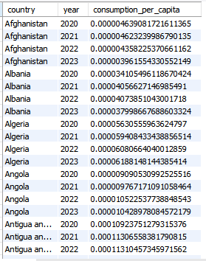
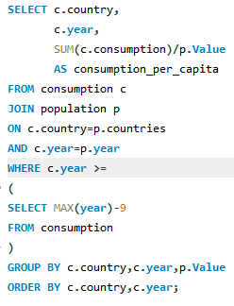
Analysis Queries
Query 8: What is the energy consumption per capita for each country over the last decade?

Slide 16
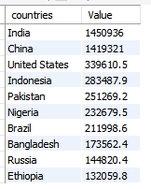
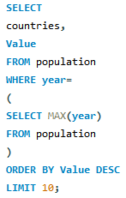
Analysis Queries
Query 9: What are the top 10 countries by population?

Slide 17
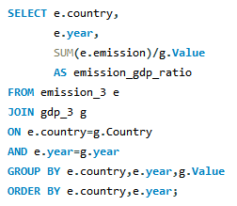
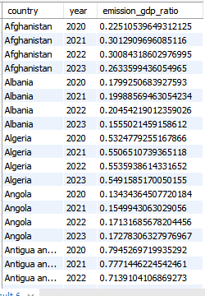
Analysis Queries
Query 10: What is the emission-to-GDP ratio for each country by year?

Slide 18
Business Insights
Key Insights
Successfully managed and analyzed worldwide energy data using SQL.
Countries with higher energy consumption generally show higher carbon emissions.
GDP growth is often associated with increased energy demand.
Per-capita analysis highlights differences in energy efficiency between countries.
Energy production and consumption vary significantly across regions.
Carbon emissions are concentrated in a limited number of major economies.
Foreign key relationships ensured data integrity and consistency across all datasets.

Slide 19
Recommendations & Future Scope
Recommendations:
Promote renewable and clean energy sources to reduce carbon emissions.
Improve energy efficiency in high-consumption sectors.
Encourage sustainable energy policies based on data-driven analysis.
Monitor emission-to-GDP ratios to balance economic growth with environmental sustainability.
Future Scope:
Develop interactive dashboards using Power BI.
Integrate real-time global energy datasets.
Apply Machine Learning to forecast future energy demand and emissions.
Expand the database with renewable energy and climate indicators.

Slide 20
Conclusion
Successfully designed and analyzed a Worldwide Energy Consumption Analysis database using SQL.
Integrated six interconnected datasets using primary and foreign key relationships.
Performed analysis on energy consumption, production, GDP, population, and carbon emissions.
Identified meaningful trends and comparisons through SQL queries and data analysis.
Demonstrated the practical use of SQL for analyzing real-world energy datasets.
Generated valuable insights to support data-driven decision-making and sustainable energy planning.

Slide 21



Slide 22


